Slide 1
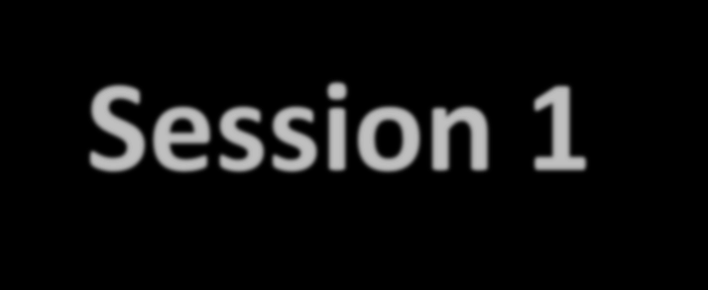

jQuery Event handling
C273 – Advanced Web Application Development in PHP
Session 1

Slide 2
What is an event?
Every element on a web page has certain events which can trigger invocation of event handlers
6 Examples of events
A mouse clicks
A web page or an image loading
Mousing over a hot spot on the web page
Selecting an input box in an HTML form
Submitting an HTML form
A keystroke

Slide 3
jQuery Events
Method / Property | Description
blur() | An element loses focus
change() | The content of a field changes
click() | Mouse clicks an object
focus() | An element gets focus
hover() | The mouse is moved over an element
submit() | The submit button is clicked
ready() | Specifies a function to execute when the DOM is fully loaded
http://www.w3schools.com/jquery/jquery_ref_events.asp

Slide 4
6 jQuery Effects
Method | Description
fadeIn() | Fades in the selected elements
fadeOut() | Fades out the selected elements
fadeToggle() | Toggles between the fadeIn() and fadeOut() methods
hide() | Hides the selected elements
show() | Shows the selected elements
toggle() | Toggles between the hide() and show() methods
http://www.w3schools.com/jquery/jquery_ref_effects.asp

Slide 5
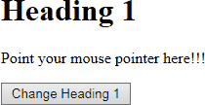
Exercise 1

Slide 6
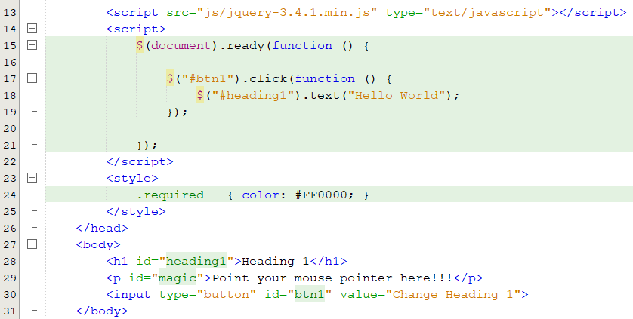
Exercise 1
Open exercise1.html

Slide 7
Exercise 1 solution
$("#btn1").click(function() {
$("#heading1").text("Hello World");
})
Change the colour of the paragraph text “Point your mouse pointer here!!!” from black to red (Use the style class “required”), when the mouse is over the text.
$("#magic").hover(function() {
$(this).toggleClass("required");
});
$("#btn2").hover(function() {
Replace the text of [Replace] button with “Hello World”
$(this).val("Hello World");
})
Make the “Heading 1” text disappear, when the mouse is over the [Make Heading 1 disappear] button.
$("#btn3").hover(function() {
$("#heading1").hide();
})
Replace the paragraph text “Point your mouse pointer here!!!” with the fontawesome icon , when the mouse is over the [Replace with icon] button
$("#btn4").hover(function() {
$("#magic").html("<i class='fa fa-dove'></i>");
})

Slide 8
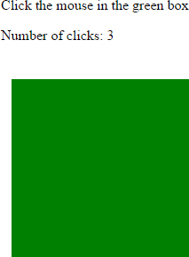
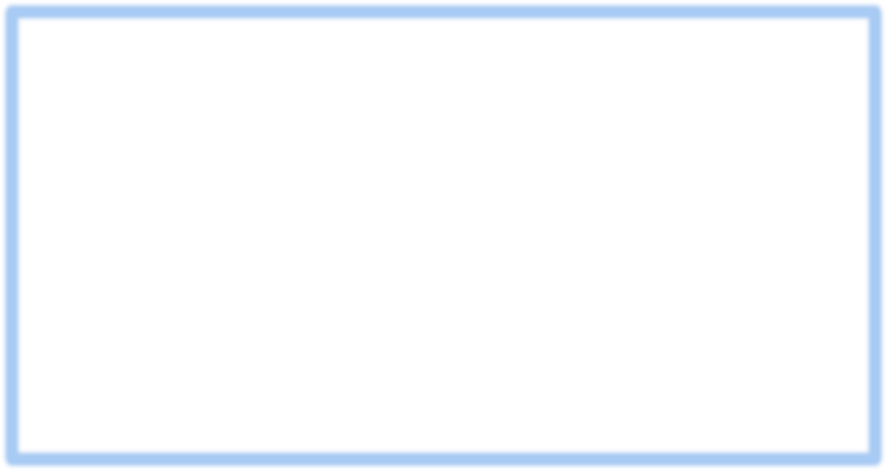
Exercise 2a
Write the jQuery code to display the number of clicks in the green box
$(document).ready(function () {
var num = 0;
$(".greenbox").click(function () { num++;
$("#numClicks").html(num);
})
});

Slide 9
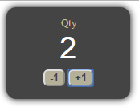

Exercise 2b
write the jQuery code to increase or decrease the quantity by
1 depending whether the user clicks “-1” or “+1”
$(document).ready(function () {
var num = 0;
$("#down").click(function () { num--;
$("#qty").val(num);
});
$("#up").click(function () { num++;
$("#qty").val(num);
});
});

Slide 10
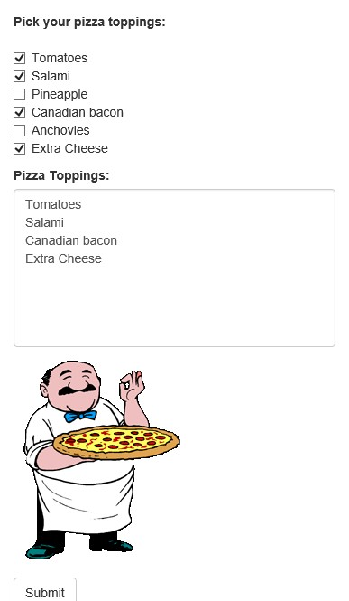
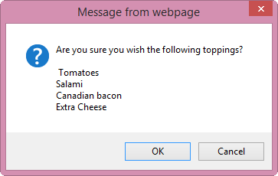
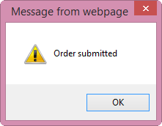
Exercise 2c
Write the jQuery code to display the selected Pizza Toppings in the text area when the user checks each topping.

Slide 11

Exercise 2c - solution
Attach a click event listener to all checkboxes
$(document).ready(function () {
$("[type=checkbox]").click(function () {
var message = "";
$("[type=checkbox]:checked").each(function() { message += $(this).val() + "\n";
})
$("#results").val(message);
Loop through all checked checkboxes to get the value of each checkbox
});

Slide 12

Exercise 2c - solution
$("#pizzaform").submit(function () { var message = $("#results").val();
var tmp = confirm("Are you sure you wish to have the following toppings? \n\n"+ message);
if (tmp == true) {
alert("Order submitted");
return true
Form is submitted
} else {
return false;
Stay on the current page
}
})
});

Slide 13
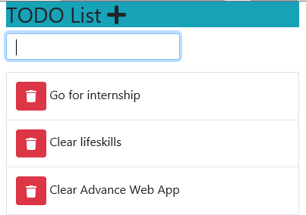
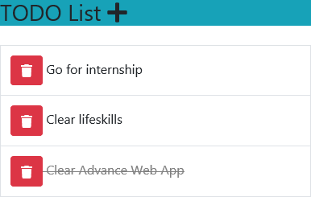
Exercise 2d
Write the jQuery code to:
Click on the “+” icon to hide the “Add New Todo” text field. Click it again to show it.
User fills up the “Add New Todo” text field and hits the “Enter” key to insert the new todo in the list below.
User clicks on the trash icon to remove that item from the list.
User clicks on any list item to cross out that item (i.e. mark as completed)

Slide 14
Exercise 2d solution
$(".fa-plus").click(function(){
$("input[type='text']").fadeToggle();
});
Show/Hide text field upon
clicking on the plus icon
$("input[type='text']").keypress(function(event){ if(event.which === 13){
var todoText = $(this).val();
$(this).val("");
Detect “Enter” keypress
Append a table row with the todoText
$("table").append("<tr><td><button class='btn btn-danger'>
<i class='fa fa-trash'></i></button> " + todoText + "</td></tr>"); return false;
}
});
Attach click handler to a dynamically created button using the on() method
$("table").on("click", ".btn-danger", function(event){
$(this).parent().parent().remove();
});
<button> <td>
<tr>
$("table").on("click", "tr", function(){
$(this).toggleClass("completed");
Gray out and strike through the
});
contents in the <tr>

Slide 15
Form Validation
What format do you expect?
Letters, numbers, symbols?
Length: between 2 and 12 chars?
Username
Numeric
Exactly 8 characters
Starts with 8 or 9
HP number (SG)
@ symbol
. after the @ symbol
2,3 or 4 characters after last
dot, etc.
Email address

Slide 16
Regular Expression
Regular Expressions are used to find certain patterns of text, for example, finding email addresses in a long text
Note that each regular expression is enclosed with /^
and $/ symbols.
^ indicates the beginning of the string. Using a ^ metacharacter requires that the match start at the beginning of the string.
$ indicates the end of the string. Using a $ metacharacter requires that the match end at the end of the string.

Slide 17
Regular Expression Examples
RE | Explanation | Examples of valid entries
[0-5] | A digit between 0 and 5 | '3' or '1'
[0-5]* | 0 or more digits between 0 and 5 | '321' or ''
[0-5]+ | 1 or more digits between 0 and 5 | '321' or '1'
[2-6]{4} | Exactly 4 digits between 2 and 6 | '5435' or '2266'
[a-z]* | 0 or more lowercase alphabets | 'hello' or '' or 'one'
[A-Z]* | 0 or more uppercase alphabets | 'HELLO' or '' or 'ONE'
\w{4} | Exactly 4 characters long words | 'four' or 'LOOP' or 'Zone'
\d{4,6} | 4, 5 or 6 digits | '1243' or '663944' or '53521'
[A-Z]{2}[0-9]{4} | Two uppercase alphabets followed by 4 digits | 'AB2231' or 'GG2400'
.+ | 1 or more digits or characters | 'a' or '9' or 'axy' or 'a1h' or 'x456'
Resource: http://regexone.com

Slide 18
Exercise 3
Format | Regular expression
Singapore mobile telephone number | [89][0-9]{7} [8-9][0-9]{7} [89]\d{7}
Singapore residential telephone number |  | [6][0-9]{7}
 | [6]\d{7}
Singapore NRIC | [SFTG][0-9]{7}[A-Z] [SFTG]\d{7}[A-Z]
Singapore postal code | [0-9]{6} \d{6}

Slide 19
Client / server side validation
Client side:
Form data is checked in the browser
JavaScript is used to check
Form data is checked before it is sent to the server
Server side:
Form data is checked on the server
PHP is used to check
Form data is checked before you insert them into the database

Slide 20
Client-side
Client / server side validation (2)
Server-side
Faster
No transmission of data
First check
Client side can be bypassed
More secure for application
Make sure both checking are consistent

Slide 21
jQuery Form Validation
var zipCode= $("[name=zipCode]").val();
if (zipCode === "") {
alert(“Zip code is required”);
}else if ((/^\d{5}$/).test(zipCode)===false) {
alert("You must enter a valid Zip code.“);
}
From http://www.w3schools.com/js/js_form_validation.asp

Slide 22
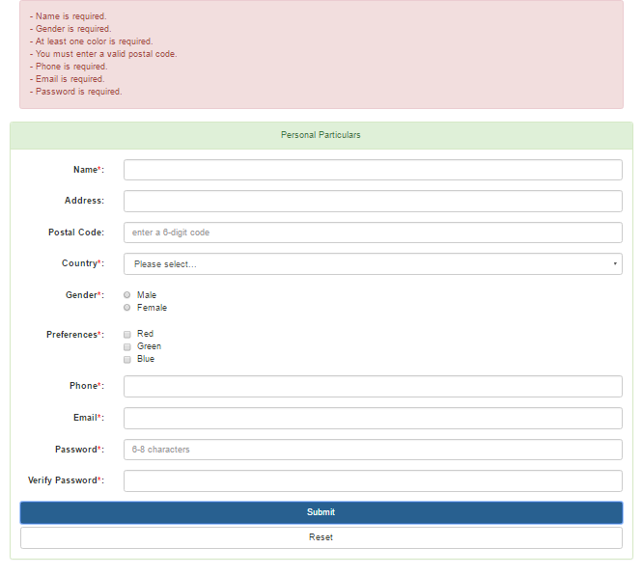
Exercise 3
Open exercise3.html

Slide 23
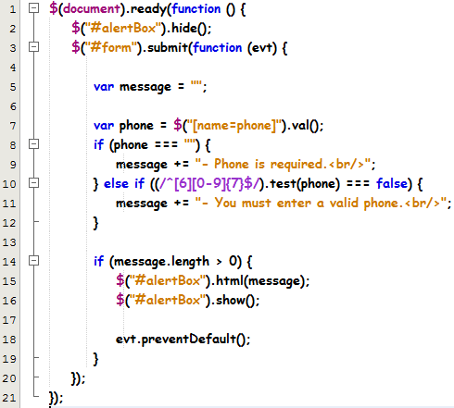
Exercise 3
Check if the phone is empty and if it is in a valid Singapore residential phone format.

Slide 24

Exercise 3a - solution
Validating all required text fields
var name = $("[name=name]").val(); if (name === "") {
message += "- Name is required.<br/>";
}
var country = $("[name=selCountry]").val(); if (country === "") {
message += "- Country is required.<br/>";
}

Slide 25


Exercise 3b - solution
Validating the selection of radio buttons
if ($("[name=gender]").is(":checked") === false) { message += "- Gender is required.<br/>";
}
Validating the selection of check boxes
if ($(".chkboxlist").is(":checked") === false) {
message += "- At least one color is required.<br/>";
}
Take note that using the selector
$("[name=color[]]") will not work!

Slide 26


Exercise 3g - solution
Validating the format of postal code and email
Postal code is an optional field, so
message += "- You must enter a valid postal code.<br/>";
}
}
Email is a mandatory field, so two
var postalCode = $("[name=postalcode]").val();
if (postalCode != "") {
if ((/^[0-9]{6}$/).test(postalCode) === false) {
if the user enters something,
make sure it’s a valid postal code
format
var email = $("[name=email]").val();
if (email === "") {
message += "- Email is required.<br/>";
validations are needed: checking of empty field and valid email
format
} else if ((/^(\w+[\-\.])*\w+@(\w+\.)+[A-Za-z]+$/).test(email) === false) { message += "- You must enter a valid email.<br/>";
}

Slide 27
Exercise 3d and e - solution
Validating the format of passwords and both “password” and
“verify password” fields must match
var password = $("[name=pwd]").val(); if (password === "") {
message += "- Password is required.<br/>";
} else if ((/^[A-Za-z\d]{6,8}$/).test(password) === false) { message += "- You must enter a valid password.<br/>";
}
var verifyPassword = $("[name=verifypwd]").val(); if (verifyPassword === "") {
message += "- Confirm password is required.<br/>";
} else if (password !== "" && password !== verifyPassword) { message += "- Passwords do not match.<br/>";
$("[name=pwd]").val("");
$("[name=verifypwd]").val("");
}

Slide 28
What you learnt today
Demonstrate understanding of Document Object Model (DOM) manipulation to HTML and CSS
Identify the various HTML events
Differentiate event handling using HTML event attributes and using JQuery
Add event using HTML DOM
Build regular expression and test using an offline tool

